Slide 1

Emerging Challenges in Web Application Security: Defence Strategies
Members(SAF):
Devina Shah (40238009)
Pratiksha Pole (40230412)
Zoha Fatima (40230911)

Slide 2
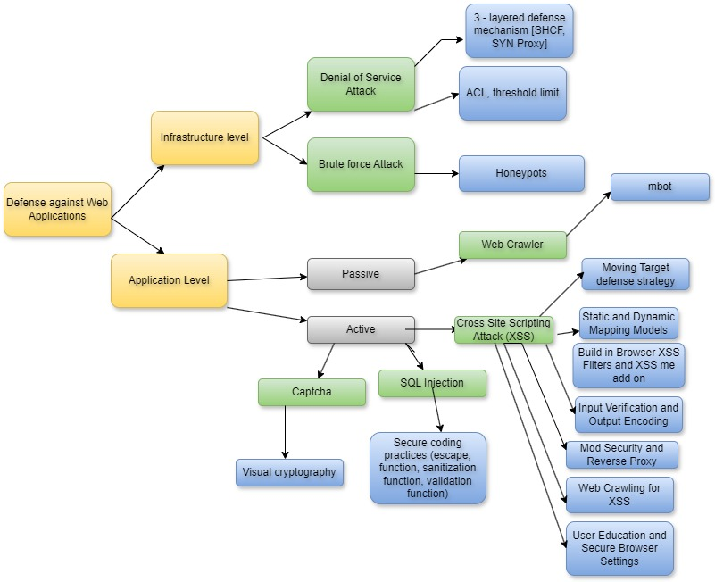
Work Outline: Classification of our work

Slide 3
Defenses Against Web Application Attacks
Introduction: Web applications face increasing threats. Learn how to defend against attacks and secure your digital assets.
Purpose: To explore and understand different defense strategies against well known attacks on web applications, to henceforth develop applications that can be made secure at the development and maintenance level.
Agenda
Understanding Classifications
Going over some top Defenses
Comparing defense strategies and Analysis

Slide 4
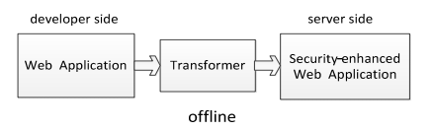
Defense Against Cross Site Scripting
Cross Compare Difference Defense against XSS
Layered Defense Implementation: Defenses are applied at different levels—client-side (e.g., browser defenses), server-side (MTD, ModSecurity), and network-level (e.g., CXSSor).
Automation vs Manual Intervention: Some methods are highly automated (e.g., CXSSor) for efficient threat detection, while others rely on manual actions or user compliance.
Proactive vs Reactive Defense: Tools like CXSSor are proactive, identifying vulnerabilities before exploitation, whereas browser-based defenses react to attacks as they occur.
Coverage vs Specific Focus: Some techniques provide broad coverage (e.g., input verification, output encoding), while others focus on specific XSS aspects (e.g., static/dynamic mapping models).
Moving Target Defense (MTD) Technology
The proposed XSS defense utilizes Moving Target Defense technology, which dynamically alters system configurations, hindering attackers by making the system less predictable and more resilient.

Slide 5
Moving Target Defense (MTD) Technology
Proposed Defense Method
Transformer Tool: A specialized tool traverses the web application, adding a unique, random runtimeId attribute to potentially vulnerable elements.
Server-Side Processing: Before sending to the client, the server alters HTML elements to include these dynamic attributes.
Client-Side Verification: JavaScript functions in the client's browser verify the runtimeId to validate the legitimacy of script executions.
Random ID Generation: Each page instance has a different runtimeId, ensuring that injected scripts without a valid ID are not executed.
System Efficiency: The method is effective against XSS attacks and imposes minimal performance overhead on the system.
Testing on Vulnerable Web Applications:
Applied the MTD-based XSS defense to web applications known for XSS vulnerabilities (like DVWA, WordPress, osCommerce). Successfully blocked all tested XSS attacks.
Performance Impact Assessment:
Minimal impact on web application performance, with an average increase in page response time of just about 10ms, demonstrating efficiency alongside security enhancement.

Slide 6
Defense Mechanisms Against SQL Injection in DVWA
The research examines the susceptibility of the Damn Vulnerable Web Application (DVWA) to SQL injection attacks using a combination of Burp Suite , SQLMap, and Acunetix. These tools collectively facilitate a detailed exploration of potential vulnerabilities, highlighting the critical role of sophisticated security measures in safeguarding web applications.
Burp Suite:
Used for intercepting and manipulating web traffic to uncover potential SQL Injection points. Through altering HTTP requests, attacks were simulated to exploit the application’s handling of user input, identifying points where SQL code could be injected.
SQL Map:
Automates the process of detecting and exploiting SQL injection vulnerabilities. Error-Based attacks exposed data through database errors, Blind SQL Injection inferred database structures without errors, and Time-Based attacks detected vulnerabilities by response delays.
Acunetix:
Scans for a wide range of vulnerabilities , with an emphasis on SQL Injection. Utilized crafted inputs to identify how different responses from the application could indicate underlying vulnerabilities, providing a broad vulnerability landscape.

Slide 7
Defense techniques by security level ( Secure Coding Practices)
Defense Technique | Pros | Cons
Content Security Policy | - Effectively mitigates XSS attacks by allowing only trusted sources for loading resources - Helps in preventing unauthorized data exfiltration - Provides flexibility in specifying security policies | - Requires careful configuration to avoid blocking legitimate resources - Can be bypassed by certain attack techniques
Web Application Firewall | - Provides an additional layer of defense against various attacks - Can detect and block malicious traffic in real-time - Often comes with customizable rulesets | - May introduce performance overhead - Requires regular updates to stay effective against evolving threats
Intrusion Detection System (IDS) | - Can detect both known and unknown attacks - Provides real-time monitoring and alerting - Helps in identifying security breaches early | - False positives may lead to alert fatigue - Requires regular tuning and maintenance
Code Analysis Tools | - Helps in identifying vulnerabilities early in the development lifecycle - Provides insights into potential security flaws in source code - Can be integrated into Continuous Integration/Continuous Deployment pipelines | - May produce false positives and false negatives - Requires expertise to interpret and prioritize findings
SQL Injection Prevention Mechanisms | - Effectively mitigates SQL injection attacks - Can prevent unauthorized access and data breaches - Helps in maintaining data integrity | - May introduce performance overhead - Requires careful implementation and configuration
Low Level Security: No defense, demonstrating the inherent vulnerability without input validation or sanitization.
Medium Level Security: Implements ‘mysql_real_escape_string()’ to escape special characters, offering basic protection against straightforward SQL injection attempts.
High Level Security:
my_sql_real_escape_string() : Escapes special characters, continuing medium level defenses.
stripslashes(): Removes blacklashes , countering escape character injections.
is_numeric(): Validates numerical inputs, limiting attack vectors based on non-numeric exploitation.

Slide 8




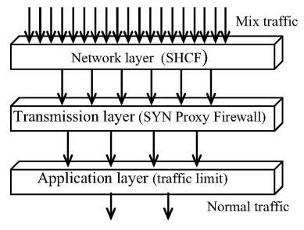

Three Layer Defense Mechanism against DDoS attack
Multi-layered approach addressing packet filtering at various network levels.
Simplified Hop Count Filtering: Identifies and blocks packets with spoofed IP addresses
SYN Proxy Firewall: Intercepts and verifies TCP connection requests.
Quota/Limit: Quota enforcement to manage bandwidth allocation.
Defending at Network Layer
SHCF(Simplified Hop Count Filtering): filters out a large volume of spoofed IP packets. It extracts the first 24-bit source IP address prefix and TTL value from the IP header.
Construct a SHCF Table-
IP Address Grouping according to the first 24 bits.
Hop-Count Determination: Packet’s 24-bit address prefix is identified, and its actual hop-count is compared with the one in the SHCF table. If difference in hop-counts exceeds two, the packet is considered spoofed and is dropped.
.

Slide 9
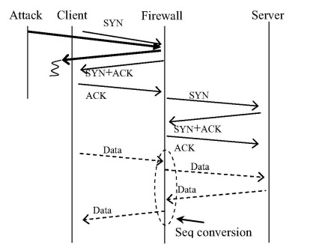
Defending at Transport and Application Layer
TRANSPORT LAYER
Attacker sends a high volume of SYN packets to a server which then allocates resources for each connection leading to quick exhaustion of resources.
The SYN Proxy Firewall acts as an intermediary between the client and the server.
The client will respond with an ACK and the firewall establishes a connection with the actual server on behalf of the client.
The firewall translates TCP sequence numbers to maintain connection state.
The firewall, upon not receiving the ACK, terminates the connection, preventing the allocation of server resources.
PROS | CONS
High Efficiency in Filtering Illegitimate Traffic: The combination of statistical filtering and traffic separating illegitimate from legitimate traffic. | Potential for Legitimate Traffic Delay or Blockage: delay or block legitimate traffic when attack patterns mimic normal traffic, leading to service disruptions.
Improved Traffic Management: ACLs can block known malicious sources, while the Threshold Limit can control the rate of traffic, reducing server overloads. | Potential for Legitimate Traffic Blockage: especially if the ACLs are too restrictive or the threshold is set too low.
APPLICATION LAYER
Attackers use genuine IP addresses and send large volumes of legitimate HTTP requests to consume server resources like bandwidth.
The system sets a limit (quota) on the amount of traffic.
When a client exceeds this quota, the bandwidth is reduced to 1/10th of their normal allocation.

Slide 10
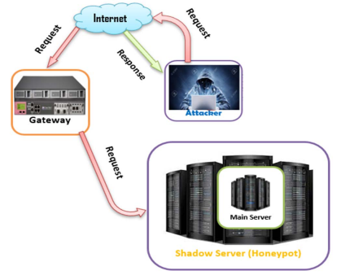



Honeypot Against Brute Force Attacks
Functionality: Honeypots create a shadow server(decoy system), simulates real system resources and tricks attackers into believing they have gained access to a real server.
The Brute Force Attack Simulation - Using Medusa Tool that identifies the target system (SSH, FTP, HTTP) and its IP address. Compiles dictionary list of usernames and passwords.
Honeypot Implementation Outcomes-
Attacker Diversion: Attackers diverted to the shadow server, thereby protecting the real server from unauthorized access.
Failed Activities: Attempts to create files, crack systems, or install backdoors by the attacker on the shadow server were unsuccessful.
Log Analysis with Kippo: logs captured attackers actions on the shadow server. System administrators monitor and analyze attack patterns.
PROS | CONS
Diversion: mislead attackers; protects real servers from unauthorized access. | Resource Intensive: Requires significant resources for setup and maintenance.
Attacker Profiling: gathers comprehensive data on attacker methods and behavior. | Potential for Misdirection: May fail to attract skilled attackers, leading to ineffective trapping.
Attack Pattern Analysis: allows administrators to monitor and analyze attack patterns providing understanding of threats. | Legal/Ethical Issues: involves complex legal and ethical considerations regarding data handling.

Slide 11
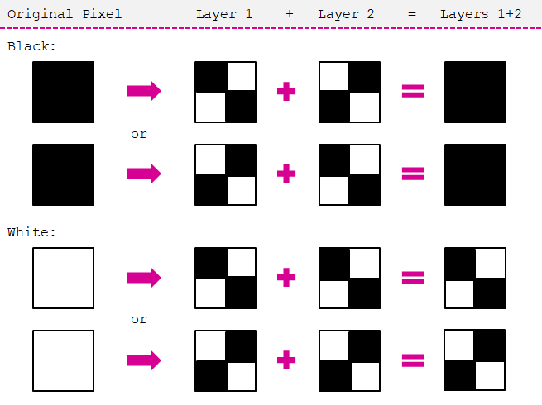
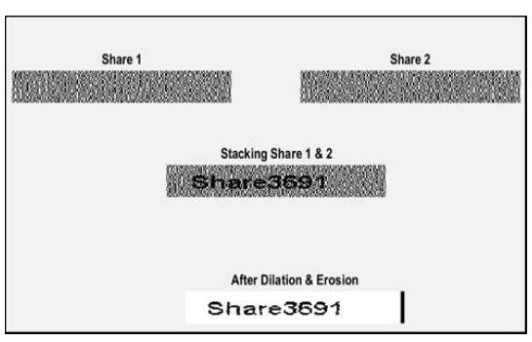
Visual Cryptography against text-based captcha attack
Method to encrypt information (like text or images) into several shares, which separately hold no discernible information but reveal the original data when combined.
During customer registration, a secret string provided by the client is combined with a randomly generated number to create a CAPTCHA image, split into two shares using VC. One share is sent to the client, and the other is kept by the bank.
Registration Phase
Login Phase
Customers provide a secret string, combined with a bank-generated number to create a unique CAPTCHA, divided into two VC shares.
During login, customers input their VC share along with their user ID. The bank combines this with its corresponding share to recreate the CAPTCHA. A match confirms the website's authenticity.
PROS | CONS
Advanced Security Layer: Offers a sophisticated layer of security against phishing, surpassing traditional CAPTCHA systems. | Computational Load: Increased computational requirements for both customers and banks.
Dual-Share Validation: Enhances authentication reliability through a unique dual-share visual cryptography method. | Complexity in Text Recognition: Potential challenges in accurately decrypting complex texts or multiple languages.
User Verification: Provides innovative approach for users to verify website authenticity. | Frequent Updates: Requires regular updates of secrets, leading to administrative challenges and user inconvenience.

Slide 12
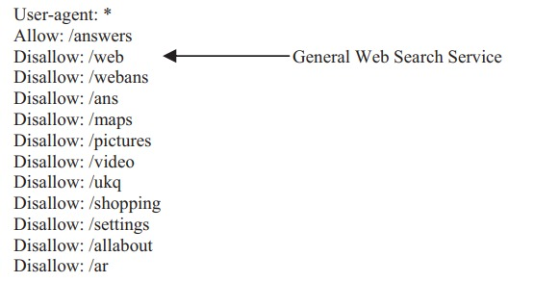
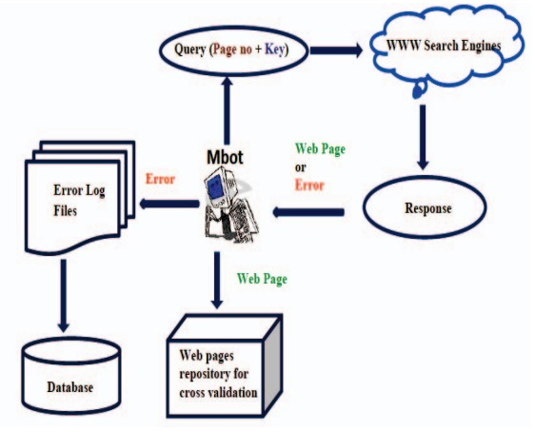
Mbots against web crawlers
robots.txt- file that specifies which parts of the website crawlers are allowed or disallowed from accessing. While compliant crawlers will adhere to these rules, this method won't stop non-cooperative crawlers.
Mbot- mimics the actions of crawlers that do not adhere to the guidelines set in the robots.txt files of websites. By acting as a non-cooperative crawler, it helps in assessing how well websites can defend against crawlers that ignore standard rules.
Mbot crawls through targeted search engine websites. It attempts to access various parts of these sites without following the restrictions typically obeyed by ethical crawlers. It collects data on how the site responds to its actions.
PROS | CONS
Enhanced Security Measures: identifying weak spots that non-cooperative crawlers could exploit. | False Positives: could potentially trigger security measures leading to false positives in system logs.
Realistic Threat Simulation: provide a real-world testing environment by simulating actual attack patterns to improve the robustness of security systems. | Resource Intensive: continuously running mbots can consume significant server resources
Early Detection: detect areas where the website may be vulnerable to scraping or unauthorized data access. | Complex Programming: Designing and programming mbots can be highly complex as requires advanced skills and resources.

Slide 13
Web Application

Slide 14
Comparison
 | DOS | XSS | Brute Force | Captcha | SQL | Web Crawlers
Attacks
Defences
3 layered Defense | Y | N | N | N | N | N
ACL & threshold limit | Y | N | N | N | N | N
Text-based captcha | N | N | N | Y | N | Y
Visual Cryptography | N | N | N | Y | N | N
Honeypots | N | N | Y | N | N | Y
Mbots | N | N | N | Y | N | Y
Static and Dynamic Mapping | N | Y | N | N | N | N
XSS-Me Add-on | N | Y | N | N | N | N
MTD Technology | N | Y | N | N | N | N
Input Verification & Output Encoding | N | Y | N | N | N | N
ModSecurity and Reverse Proxy in WAF | N | Y | N | N | N | N
CXSSor: Web Crawling | N | Y | N | N | N | N
Input sanitization | N | Y | N | N | Y | N
Validation | N | Y | N | N | Y | N
Escape | N | Y | N | N | Y | N

Slide 15
Team Member Contribution
Team Member | Research Area | Key Contributions
Devina Shah | Defense Against Cross-Site Scripting (XSS) | Analyzed contemporary XSS defense methods and integrated findings into web app security practices. Worked on classification of various defence mechanisms to structure the flow of paper.
Pratiksha Pole | Defense Against Denial of Service (DOS) Attacks | Investigated robust techniques to mitigate DOS attacks, Brute force and Captcha attacks thereby enhancing network resilience. Worked on structure and overview of the defense strategies.
Zoha Fatima | Defense Against SQL Injection (SQLi) Attacks | Explored SQLi prevention strategies, contributing to database security enhancements. Worked on weighing out pros and cons within each class of research.

